Slide 1
FLOWCHART FOR HELPINGHAND WEBSITE – FIRST PHASE DEVELOPMENT
Phase 1:
HOME
If yes, top navigation bar will be visible
ABOUT
SERVICES
CONTACT
SIGNUP/LOGIN
Top Navigation bar
Is the home page visible?
Is the about link visible?
Is the services link visible?
Is the contact link visible?
Is the sign up/login link visible?
No
Yes
No
Yes
No
Yes
No
Yes
No
Yes
BACK TO HOME
Launch page will be visible
BACK TO HOME
About us page
BACK TO HOME
Services
page
BACK TO HOME
Contact Us
page
BACK TO HOME
Parent
Sign up/Login Details
Student
Sign up/Login Details

Slide 2
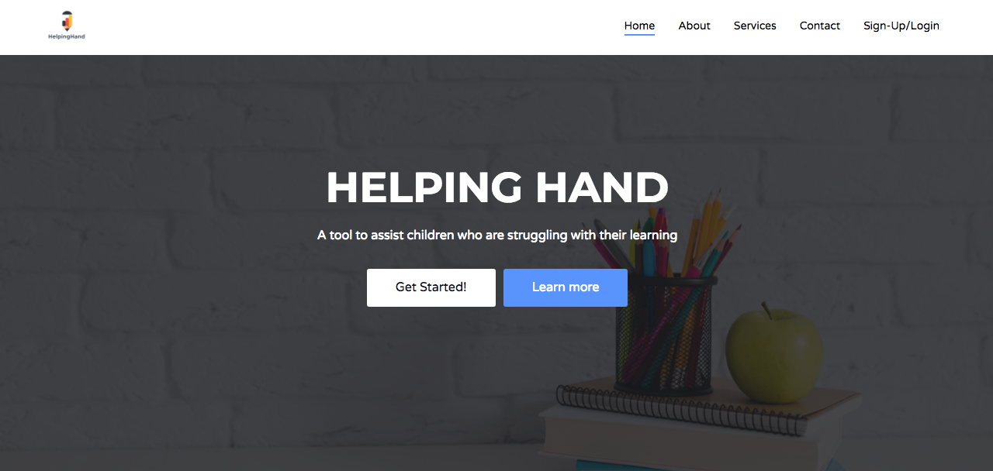
FLOWCHART FOR HELPINGHAND WEBSITE – FIRST PHASE DEVELOPMENT
Top navigation links
HelpingHand logo that directs to the homepage

Slide 3
FLOWCHART FOR HELPINGHAND WEBSITE – SECOND PHASE DEVELOPMENT – LOGIN PAGES
Phase 2:
SIGNUP/LOGIN
Top Navigation bar
Is the sign up/login link visible?
No
Yes
Parent and Tutor sign up page will be visible.
BACK TO HOME
Parent
Sign up/Login Details
Tutor
Sign up/Login Details
LOGIN FORM
LOGIN FORM
Is the login form visible?
Is the login form visible?
No
Yes
No
Yes
BACK TO SIGNUP/LOGIN
Parent can login
BACK TO SIGNUP/LOGIN
Tutor can login

Slide 4
FLOWCHART FOR HELPINGHAND WEBSITE – SECOND PHASE DEVELOPMENT
Sign-up/Login link

Slide 5
FLOWCHART FOR HELPINGHAND WEBSITE – THIRD PHASE DEVELOPMENT – LOGIN AUTHENTICATION AND USER DASHBOARD
Phase 3:
SIGNUP/LOGIN
Top Navigation bar
Is the sign up/login link visible?
No
Yes
Parent and Tutor sign up page will be visible.
BACK TO HOME
Parent
Sign up/Login Details
Tutor
Sign up/Login Details
LOGIN FORM
LOGIN FORM
Is the login form visible?
Is the login form visible?
No
Yes
No
Yes
BACK TO SIGNUP/LOGIN
Parent can login
BACK TO SIGNUP/LOGIN
Tutor can login

Slide 6
FLOWCHART FOR HELPINGHAND WEBSITE – [ ] PHASE DEVELOPMENT – BOTTOM NAVIGATION BAR
HOME
If yes, top navigation bar will be visible
ABOUT
CONTACT
SIGNUP/LOGIN
Top Navigation bar
Is the home page visible?
Is the about link visible?
Is the contact link visible?
Is the sign up/login link visible?
No
Yes
No
Yes
No
Yes
No
Yes
BACK TO HOME
Launch page will be visible
About us page
If yes, bottom navigation bar will be visible
BACK TO HOME
BACK TO HOME
Contact Us
page
BACK TO HOME
Parent
Sign up/Login Details
Student
Sign up/Login Details
Bottom Navigation bar
HOME
BUTTON
CAMERA BUTTON
ACTIVITIES BUTTON
SEARCH BUTTON
MAP BUTTON
Is the home button visible?
Is the camera button visible?
Is the activities button visible?
Is the search button visible?
Is the map button visible?
No
Yes
No
Yes
No
Yes
No
Yes
No
Yes
BACK TO HOME
Live Media Streams
BACK TO HOME
Camera Page
BACK TO HOME
Activities Page
BACK TO HOME
TAB 1
Types of Restaurants
TAB 2
User preferences
BACK TO HOME
Map page

Slide 7
About page (content about the site)
Services (will this have drop downs)
Index.html (landing page)
Contact page
Sign-up (this will link up with registration pages)
Backlog for Main website
Homepage: top navigation bar

Slide 8
{TBC}
{TBC}
{TBC}
{TBC}
{TBC}
Backlog for Main website
Homepage: bottom navigation bar

Slide 9
Login page
Signup/Login
Dashboard page
Backlog for Parent/Tutor pages
Login process

Slide 10
Enter a username
Enter email address
Enter Account Type select from dropdown (Parent)
Enter password
Confirm Password
Agree to terms and conditions
Continue
Backlog for Register pages for parents
User credentials for Parents

Slide 11
Enter First Name and Surname
Enter Address 1
Enter Title dropdown
Enter Address 2
Enter Town
Enter county (Dropdown)
Enter postcode
Enter Mobile number
Student DOB:
Day | month| year
Student Gender
Backlog for Register pages for parents
Personal Information for Parents

Slide 12
Core Subjects:
Support Subjects:
ESOL Reading
Handwriting
Select subjects you would like help with (Parent)
Complimentary subjects:
Computer Science
Art & Design
Modern Foreign Languages
Design and Technology
Tutor Preferences:
Enter details of Tutor preferences (Text box)
English
Maths
Science
History
Geography
Backlog for Register pages for parents
Subject selection for Parents

Slide 13
Enter university username
Enter university password
Enter Account Type select from dropdown (Student)
Confirm Password
Agree to terms and conditions
Continue
Backlog for Register pages for Tutors
User credentials for Students

Slide 14
Core Subjects:
Support Subjects:
ESOL Reading
Handwriting
Select subjects you are able to tutor in (Student)
Complimentary subjects:
Computer Science
Art & Design
Modern Foreign Languages
Design and Technology
How far are you willing to travel :
0-1 miles
1-3 miles
4-9 miles
9-10 miles
English
Maths
Science
History
Geography
Salary information (we need to discuss this)
Backlog for Register pages for Tutors
Subject selection for Tutors

